Slide 1
Name : Rupali Vijay Raut Internship : Ethical Hacking Task : 1 Email: rupa1613037@gmail.com

Slide 2
Task 1:

Slide 3
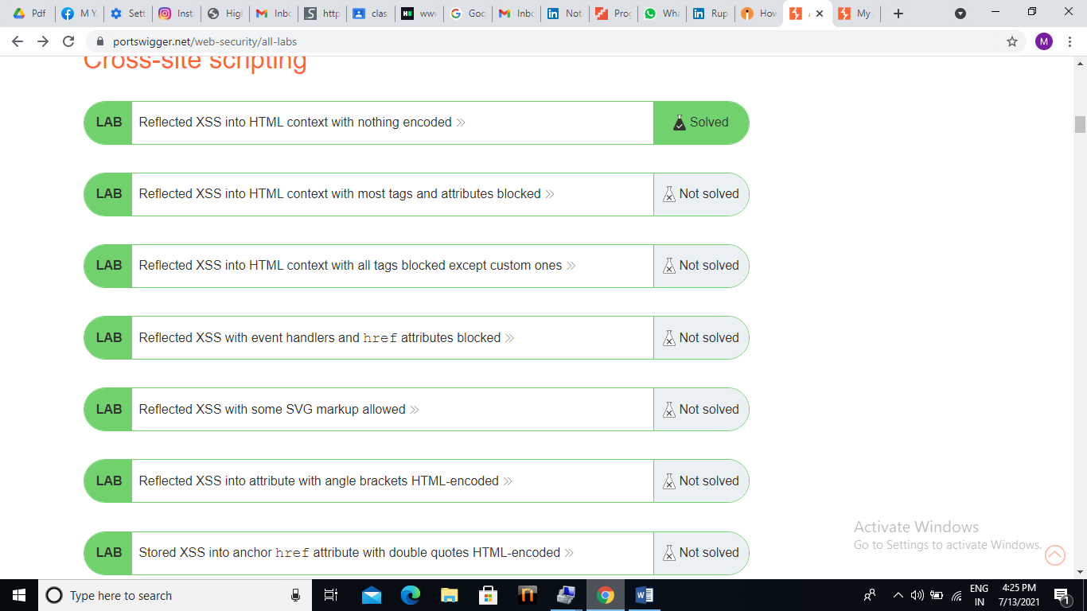

Slide 4
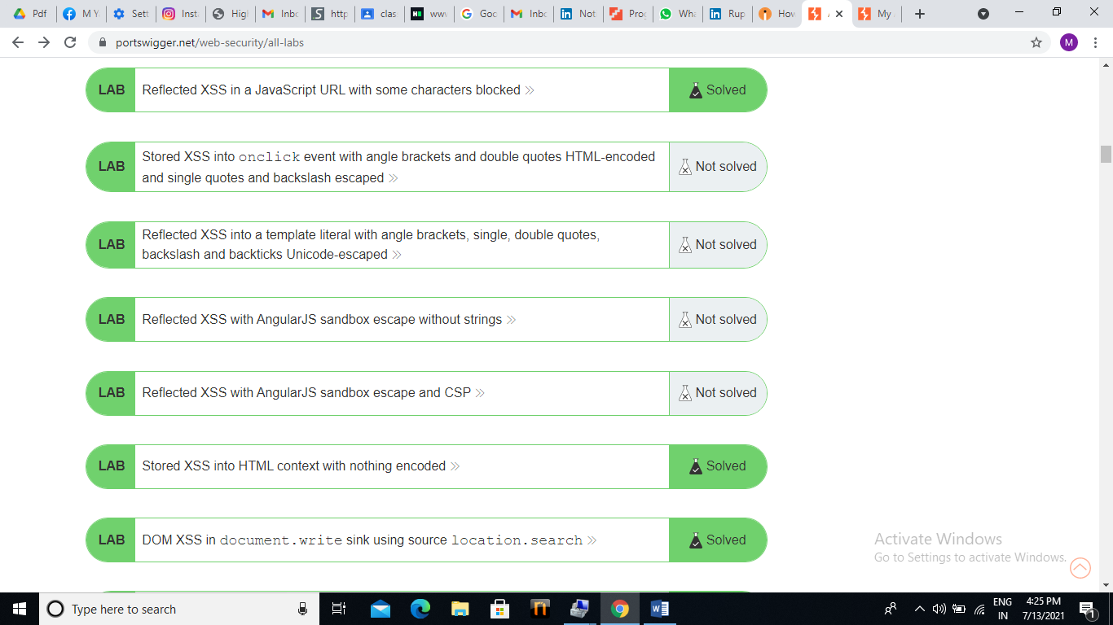

Slide 5
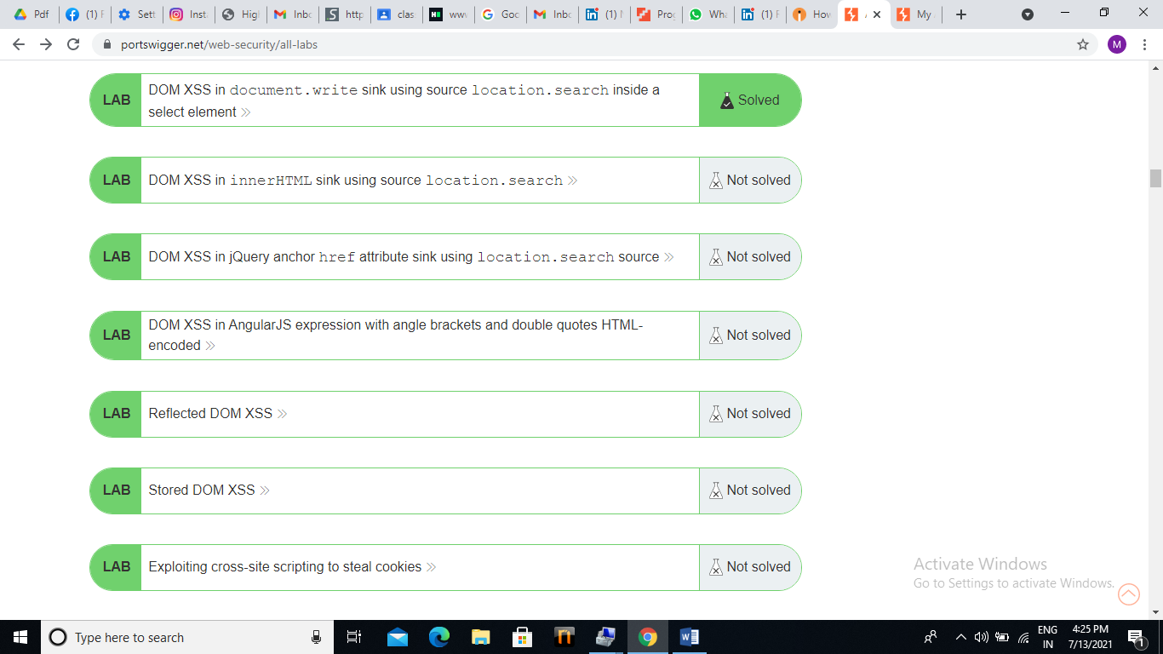

Slide 6
Hence, I successfully completed task 1…

